Slide 1

Sample Super Store
Tableau-Reinforcement-Project

Slide 2

What is Tableau?
Tableau is a data visualization tool and it allows connecting with a large range of data sources, creating interactive visualizations, and providing features to share work with other team members. It is also used by data analysts and data scientists to explore data and create visualizations that communicate understandings to others. It has an interface that allows drag-and-drop data areas to create charts, graphs, and visualizations to analyze the data which is easier to use for beginners also. It is used by businesses like medicine, technology, e-commerce, etc, to analyze data and make data-driven judgments.

Slide 3
How many chart type in Tableau?
Bar Chart: Great for comparing data across categories.
Line Chart: Ideal for showing trends over time.
Pie Chart: Useful for showing proportions of a whole.
Scatter Plot: Perfect for identifying relationships between two variables.
Histogram: Used for showing the distribution of a set of data.
Gantt Chart: Excellent for project management and scheduling.
Bubble Chart: Useful for showing the concentration of data along two axes.
Heat Map: Great for showing data density and variations.
Tree Map: Useful for showing hierarchical data.
Box-and-Whisker Plot: Ideal for showing the distribution of data based on a five-number summary.
Area Chart: Good for showing cumulative totals over time.
Bullet Chart: Useful for comparing performance against a target.
Waterfall Chart: Great for understanding the cumulative effect of sequentially introduced positive or negative values.
Packed Bubbles: Useful for showing the relationship between data points in a cluster.
Dual-Axis Chart: Allows you to compare two different measures on the same chart.

Slide 4
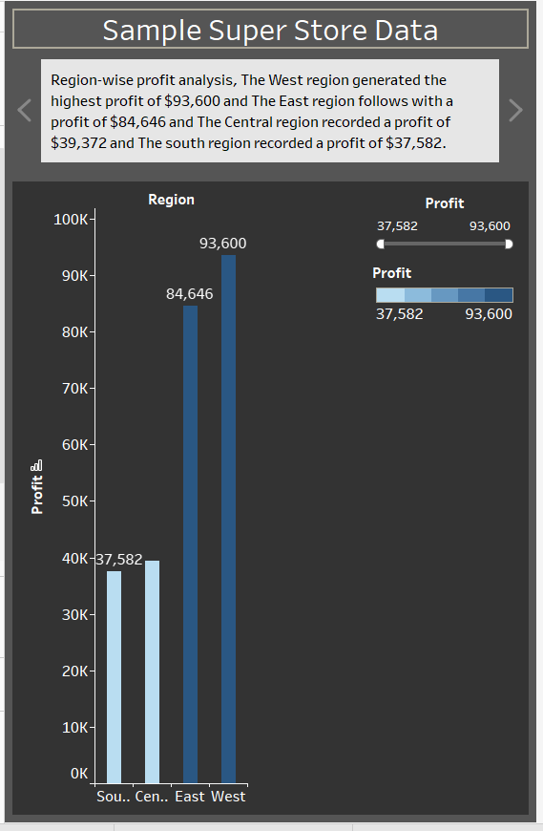

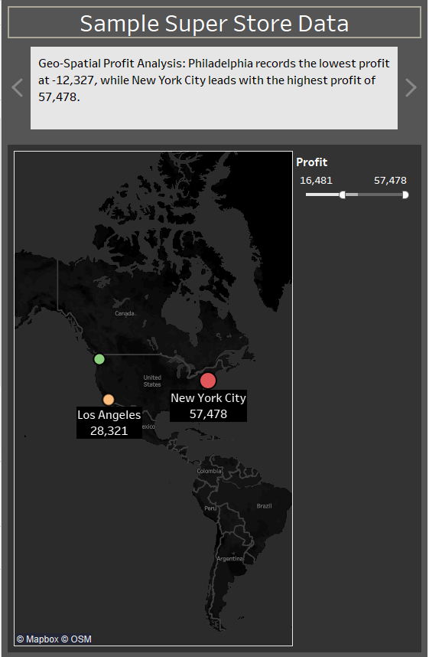

Slide 5
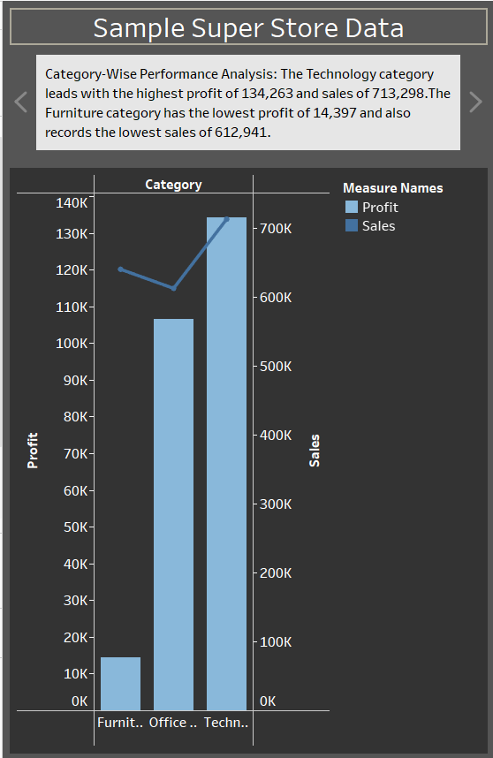
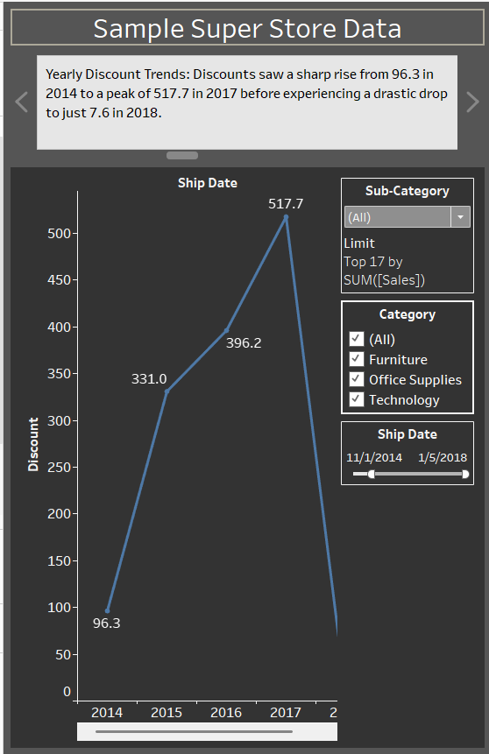

Slide 6
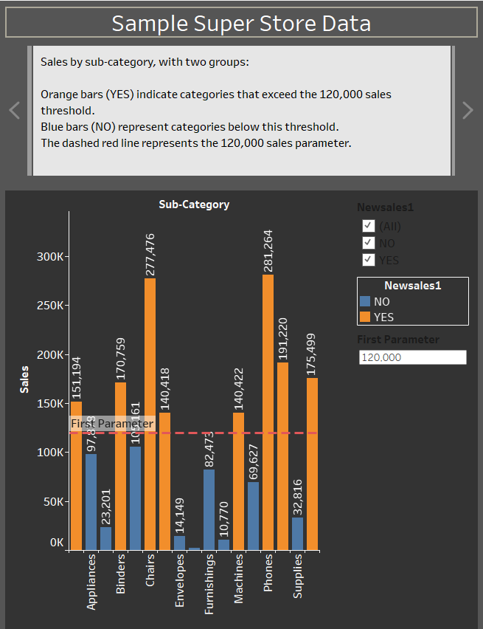
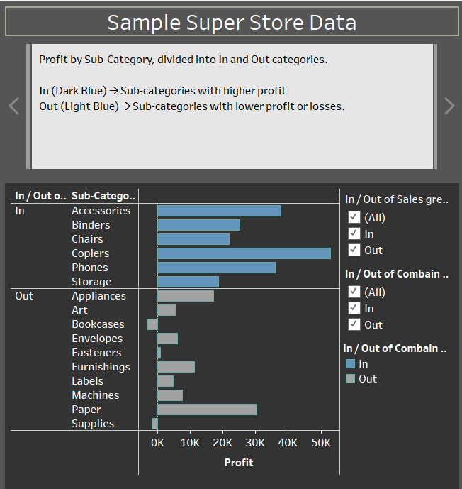

Slide 7
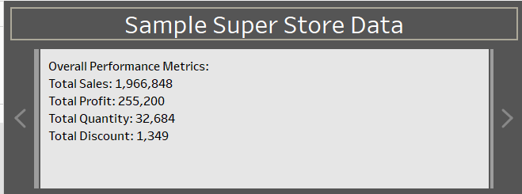
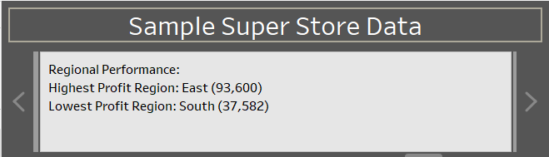
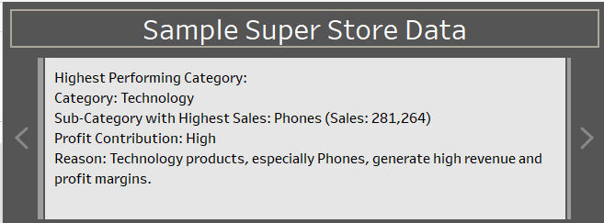
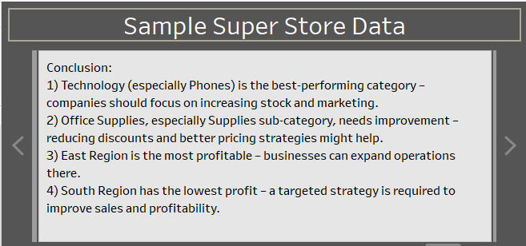
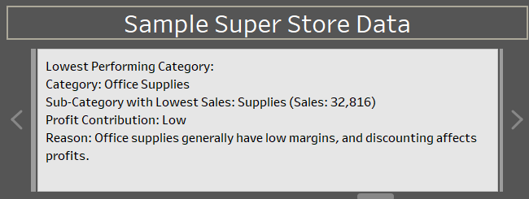

Slide 8
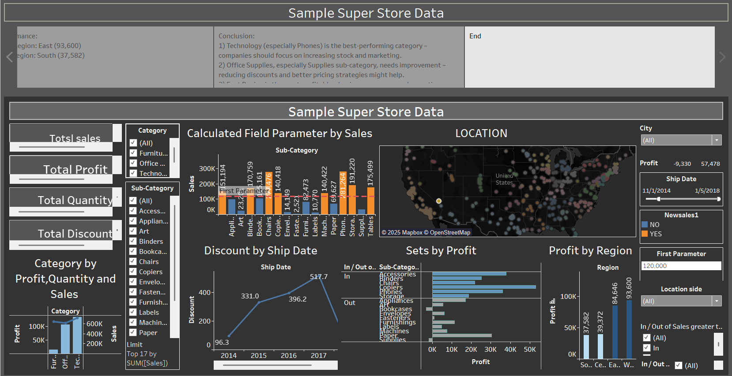

Slide 9
